Slide 1
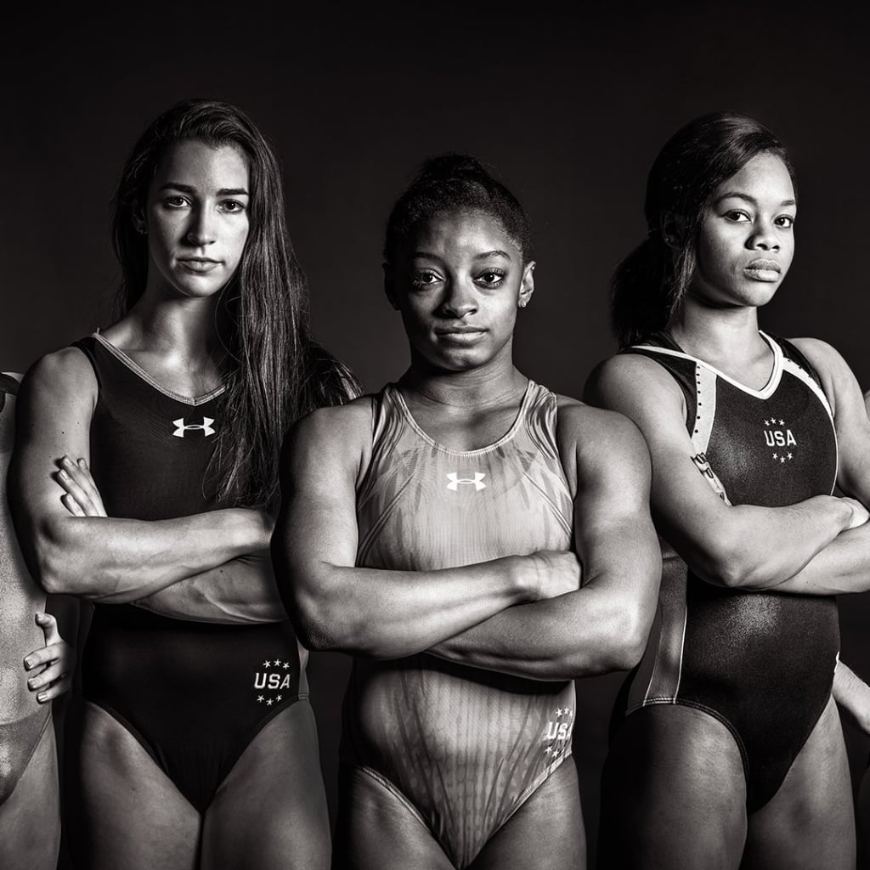
Women & the Olympic Games
By Alexander Espinosa, Ashley Lutz, Celenia Chapa, Felecia Helms, and Tyler Cutrer

Slide 2

Agenda
Team
Overview
Data
Exploration
Analysis

Slide 3





Git Sum
Alex Espinosa
Tyler Cutrer
Celenia Chapa
Ashley Lutz
Felecia Helms

Slide 4

Overview
Data Source
https://www.kaggle.com/heesoo37/120-years-of-olympic-history-athletes-and-results

Slide 5
Questions
Did Women’s participation in the Olympic Games change over the years?(Celenia)
Which sports had the biggest increase in Women participation in relation to the women’s movement? (Felecia)
What is the average age of a Female Olympian and does this average age change depending on country?(Tyler)

Slide 6
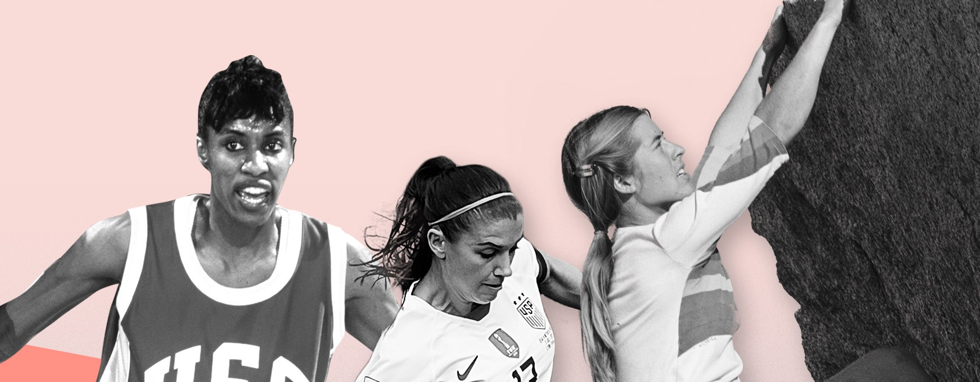
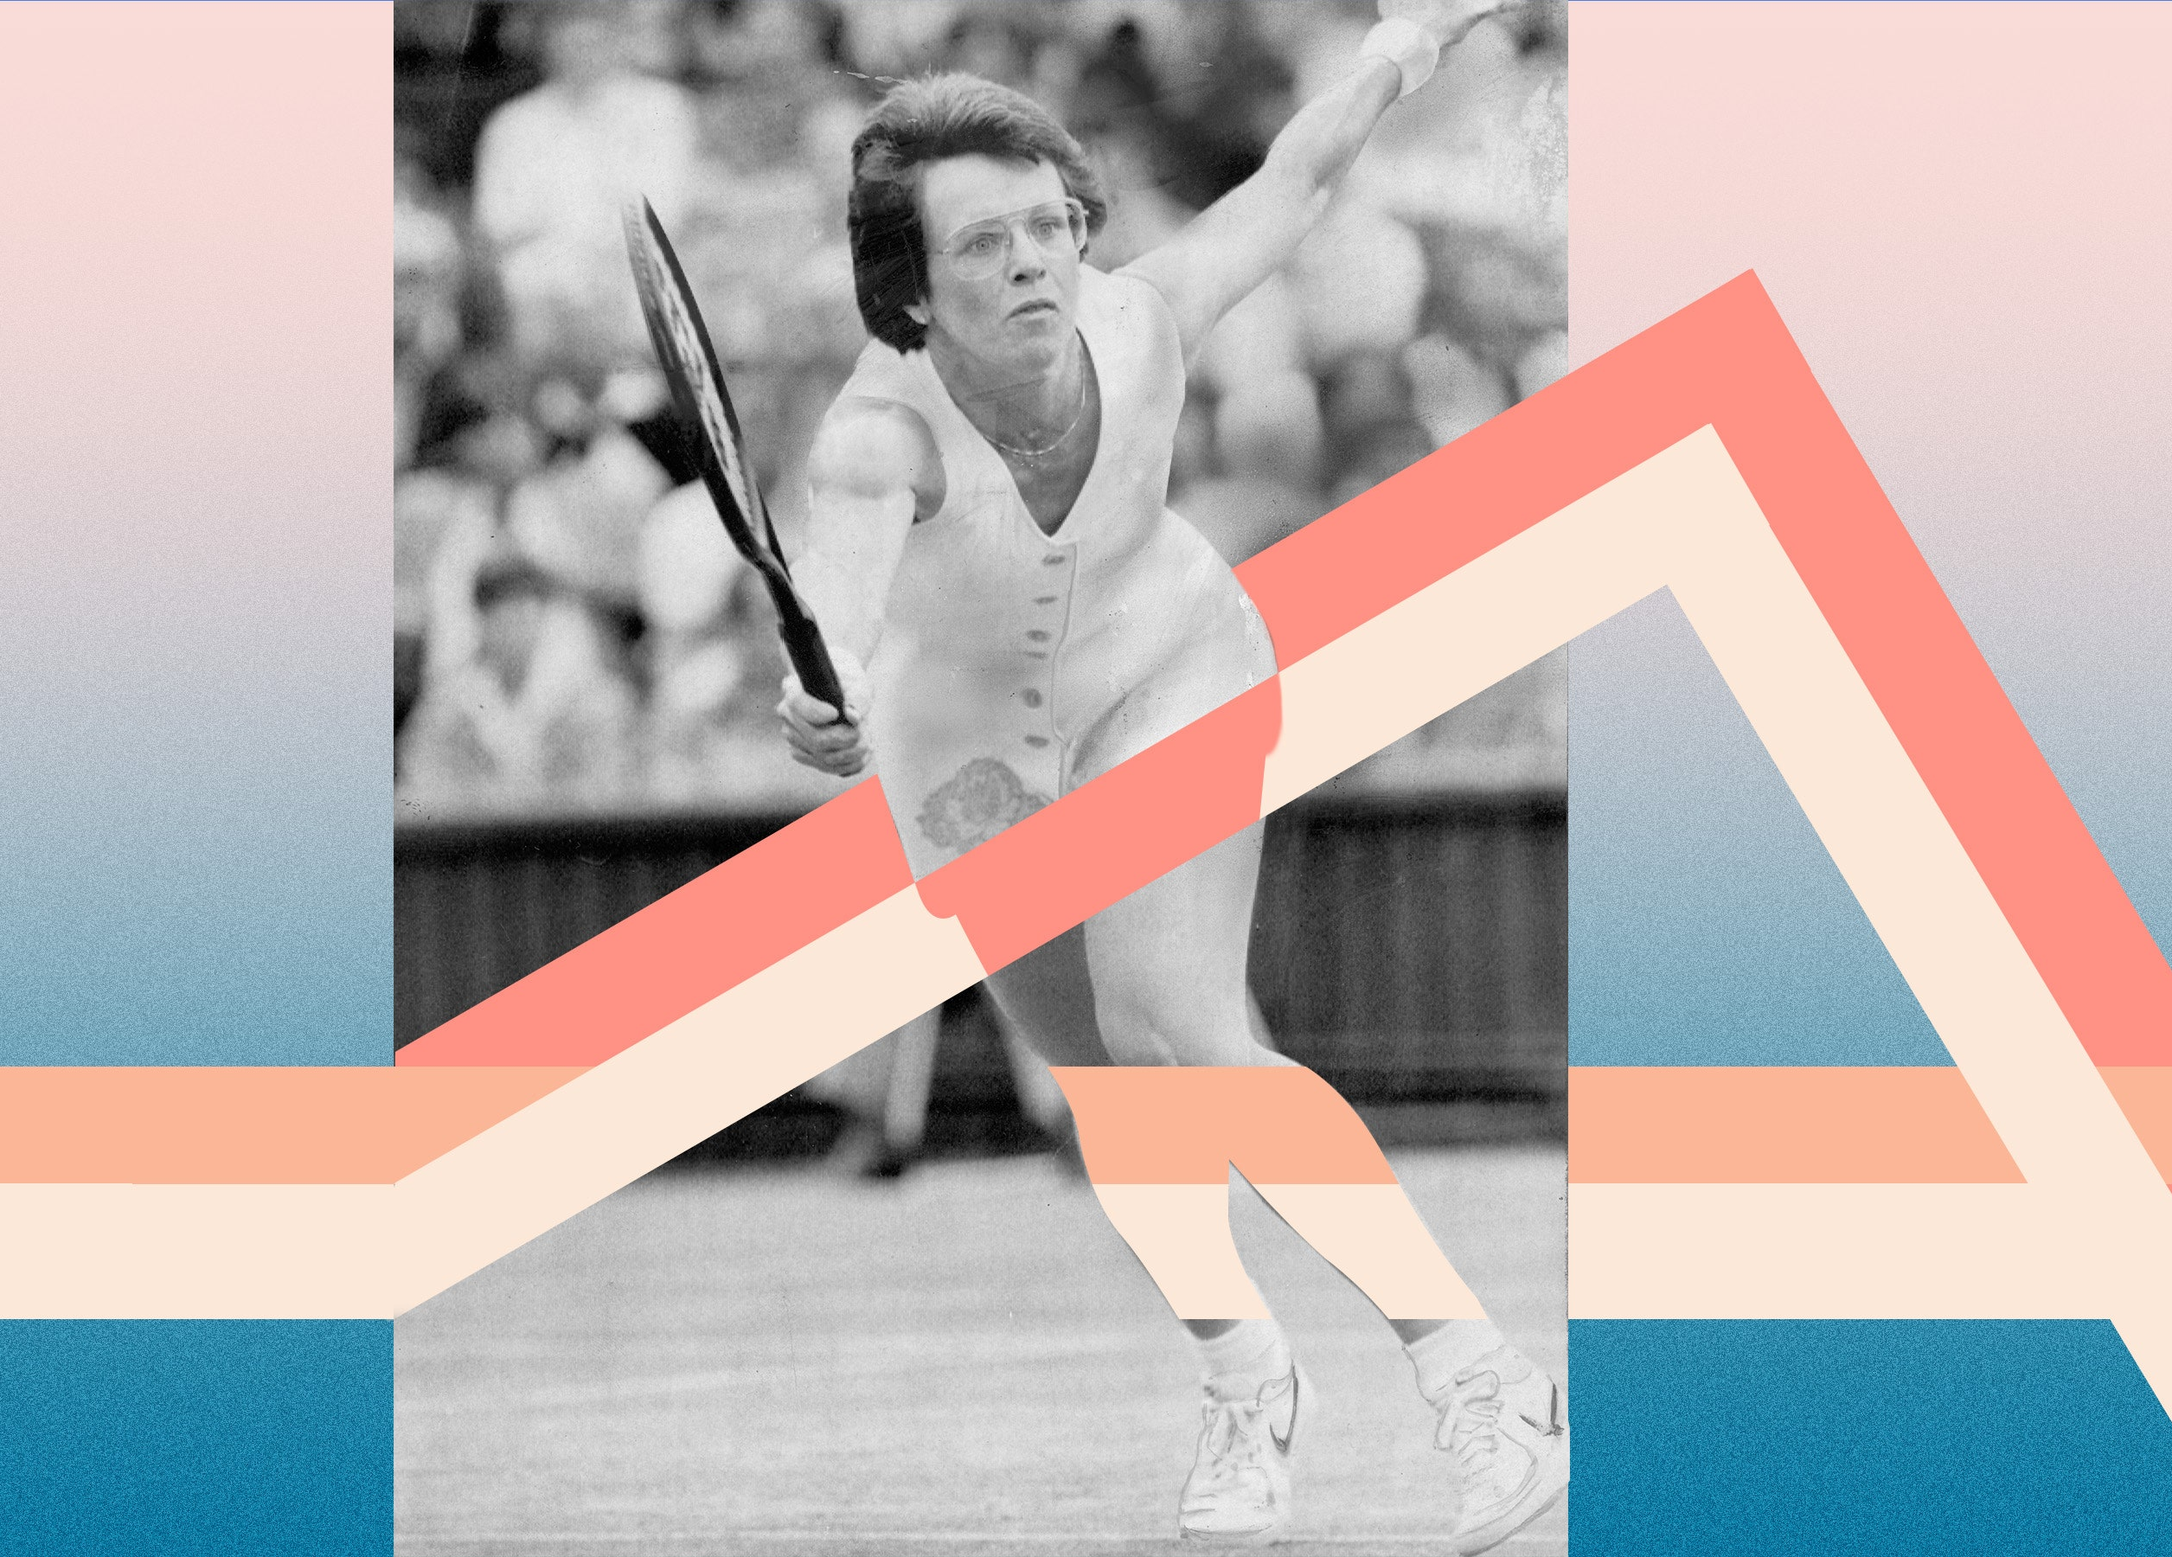
Women’s Suffrage
Historically, women are underpaid, undervalued, and overlooked at every turn. But they’re fighting back—and winning.

Slide 7
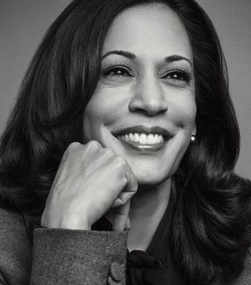
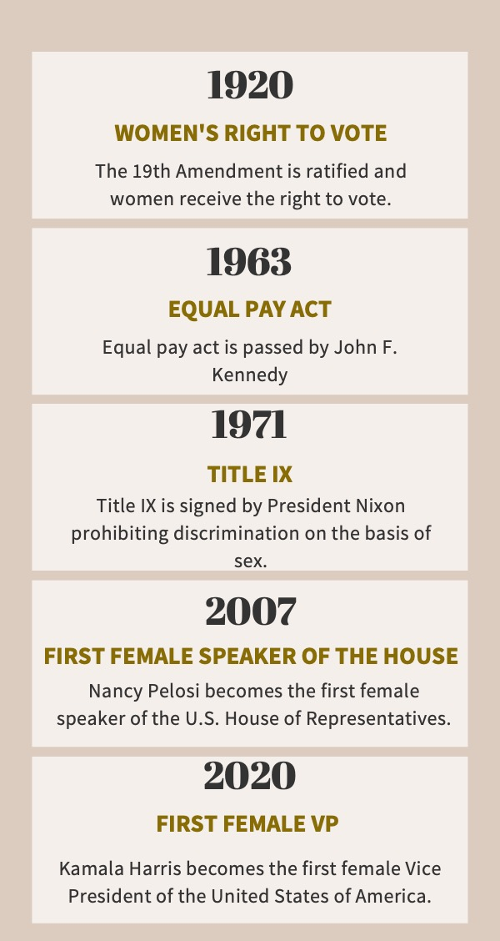
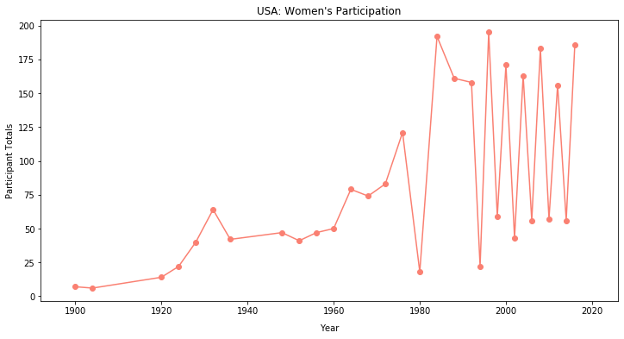
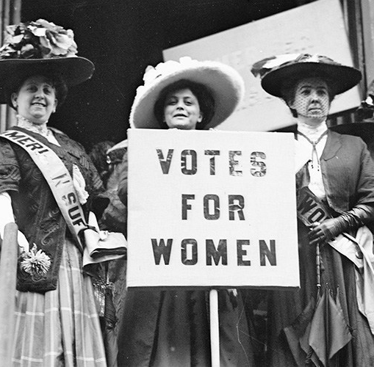
Women’s Suffrage

Slide 8
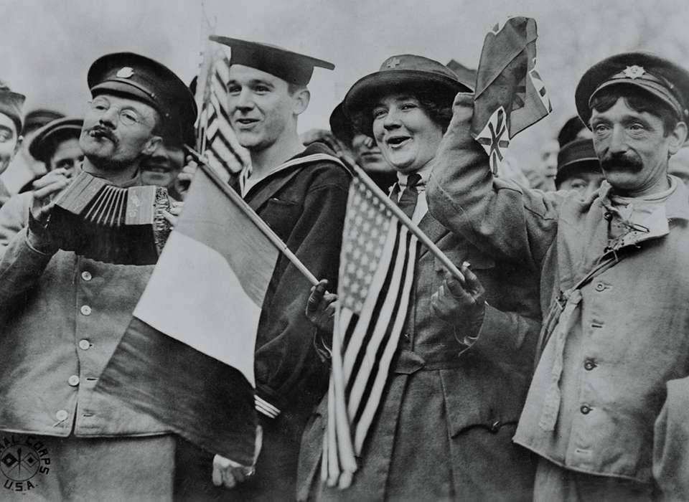
World Events
WWII: 1939-1945
Boycott: 1980s

Slide 9
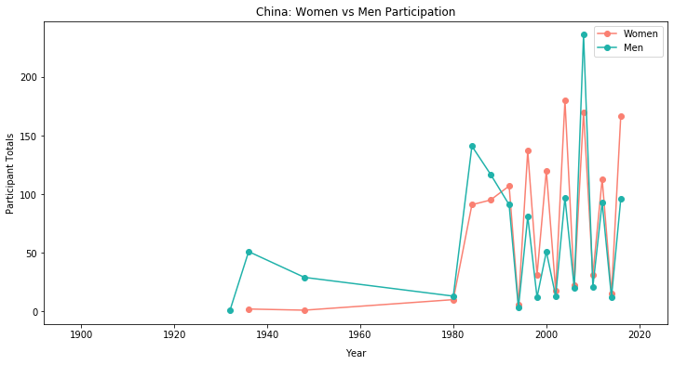
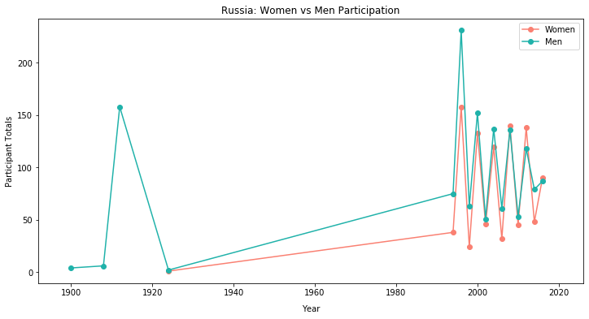
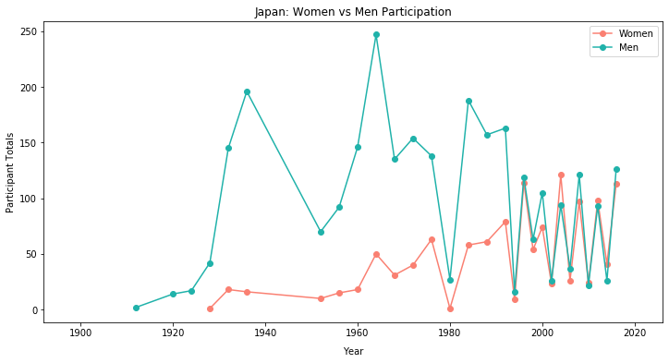
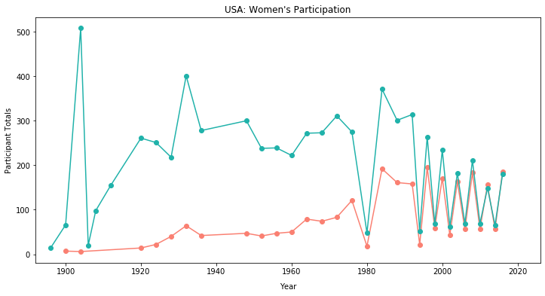
World Participation
China
Russia
Japan
USA

Slide 10
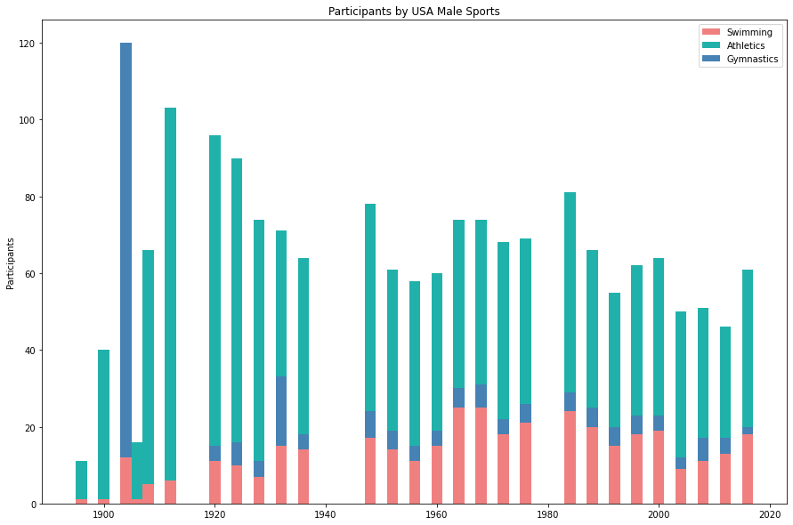
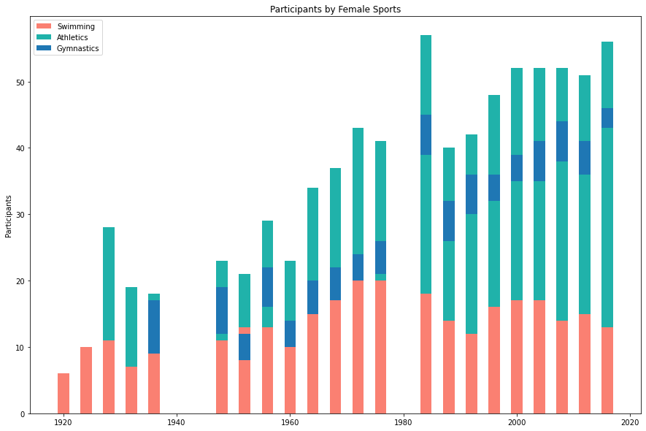

Slide 11
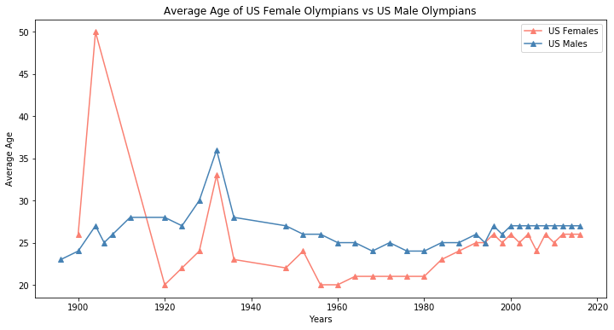

Slide 12
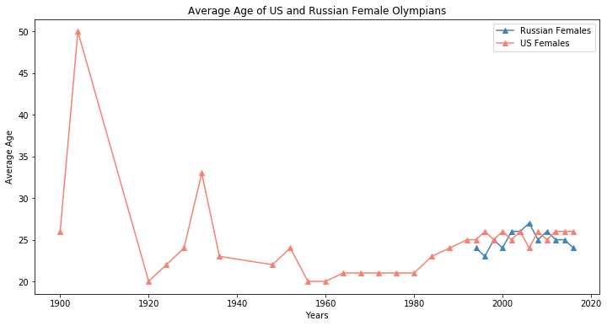
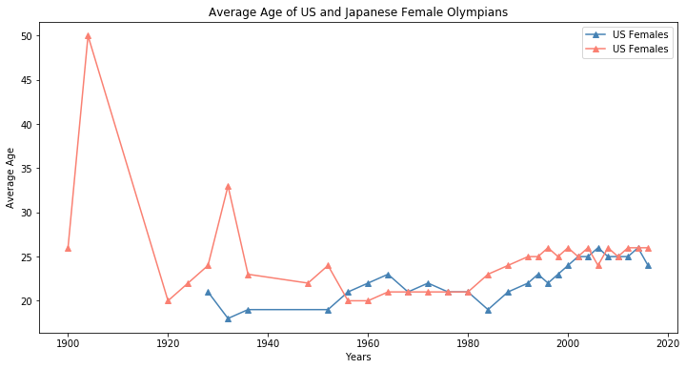
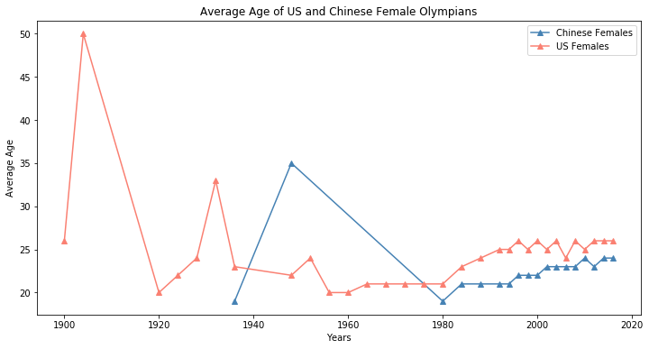

Slide 14
References

